Slide 1



Capstone Project : Understanding Cyber Security and Safety Perceptions for Digital Payments and E-Services :
Presented By Group – eShield
Rajiv, Chintan & Hardik
eShield

Slide 2
Project Team and Task Allocation
Chintan Joshi | Questionnaire Framing, Data Collection, Data Pre-Processing, Report Writing
Rajiv Trivedi | Data Collection Strategies, Exploratory Analysis, Predictive Analysis, Report Writing
Hardik Raval | Predictive Analysis , Inference, Report Writing
eShield

Slide 3
Project Introduction
Project Objectives :
Understand Safety Perception & Fraud Awareness
Insights into Online transaction
Data Collection and Confidentiality
Survey distributed with privacy and security considerations
Voluntary participation with informed consent
Data anonymized and aggregated for confidentiality
eShield

Slide 4
Method
Define research Questions
Data Collection
Data Normalization
Exploratory Analysis
Predictive Analysis
Conclusion
eShield

Slide 5
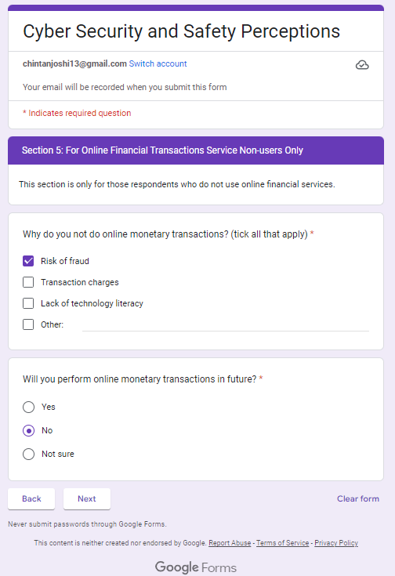
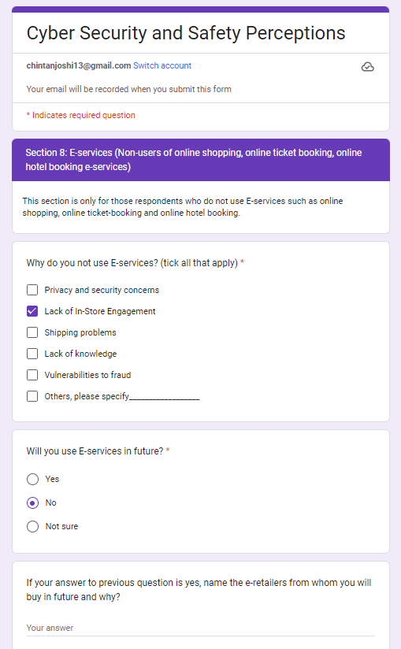
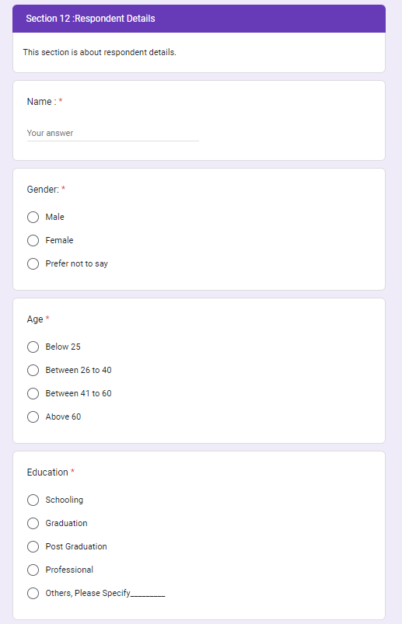
Data Collection by Survey
Information Collected via 54# Questions framed in Google Form
Sample Size > 100
Geography : Ahmedabad
Age Group : < 60 Years
eShield
https://forms.gle/eidJ1KNXuTGur3NB9

Slide 6
Define Questions for the Data
Reponses by various factors : Age, Income, Occupation
How people are concerned about Cyber Security
How much people are aware about possibilities of fraud
Who are likely to lose the money in fraud
Define Questions for the Data
Define Questions for the Data
eShield

Slide 7
Project Time Plan
Data Collection : By 5th Nov
Cleaning of Data: By 7th Nov
Data Analysis : By 10th Nov
1st Review : 7th Nov
2nd Review : 22nd Nov
3rd Review : 24th Nov
Correction and Presentation : 25th Nov
Final Report : By 2nd Dec
eShield

Slide 8
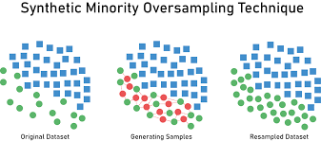
Data Normalization
Challenges Observed During Analysis
Sample Size is Small ~ 106#
Response is skewed to “ Yes” with very little information for “ No”
Data Corrected by
Added dummy columns
Fixed open text data
Removed incomplete data
Data Balanced by
Upscaling with help of SMOTE
Synthetic Minority Oversampling Technique
eShield

Slide 9
Analysis
Exploratory Data Analysis
Tableau Dashboard
Predictive Analysis
Logistic Regression
Random Forest
Market Basket
eShield

Slide 10
Method
Define research Questions
Data Collection
Data Normalization
Exploratory Analysis
Predictive Analysis
Conclusion
eShield

Slide 11
Tableau Dashboard Outputs

Slide 12
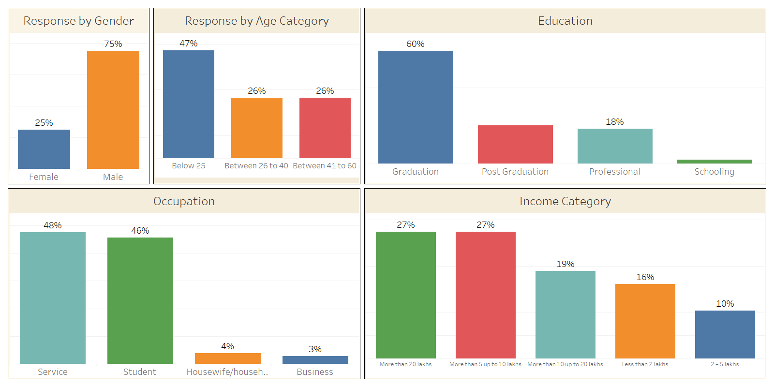
Demography
Response Summary by Respondents Demography
Define Questions for the Data
Define Questions for the Data
Total Respondents are 106#
9% among this sample are not performing Online Transactions
Out of Remaining 91%, 50% are Young Group and 50% are professionals
eShield

Slide 13
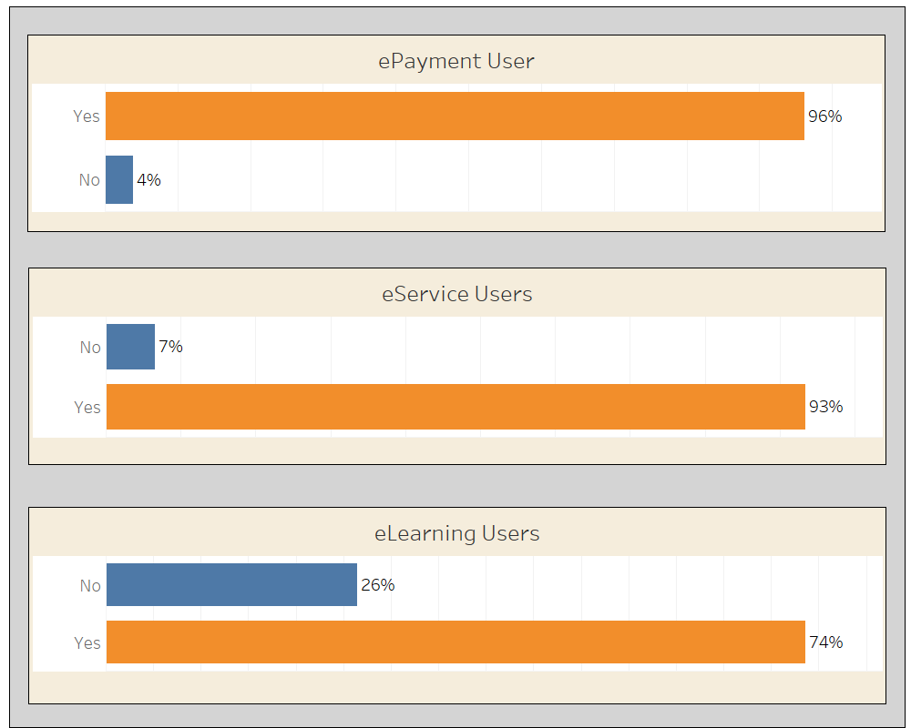
Online Users
Define Questions for the Data
Define Questions for the Data
eShield

Slide 14
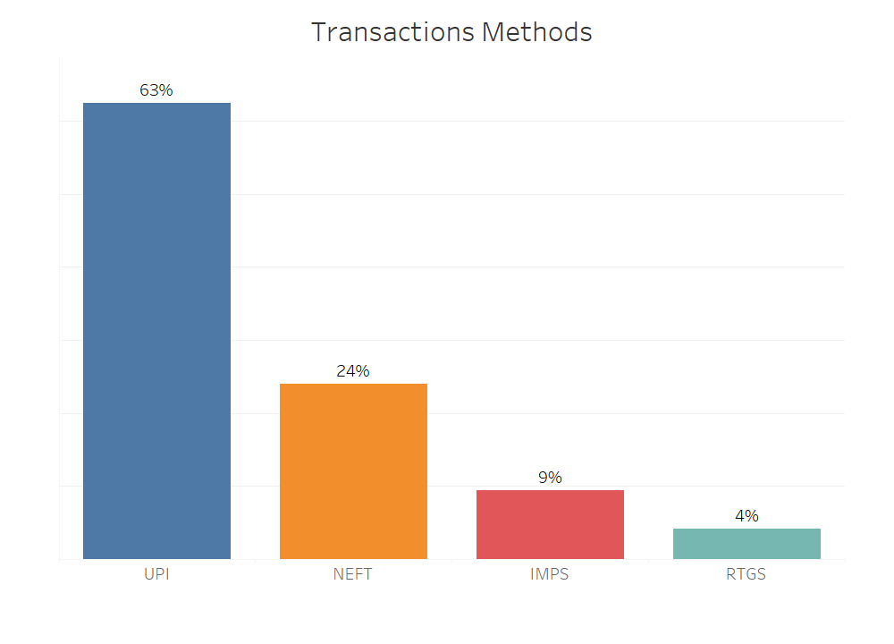
ePayment Platform
Define Questions for the Data
Define Questions for the Data
eShield

Slide 15
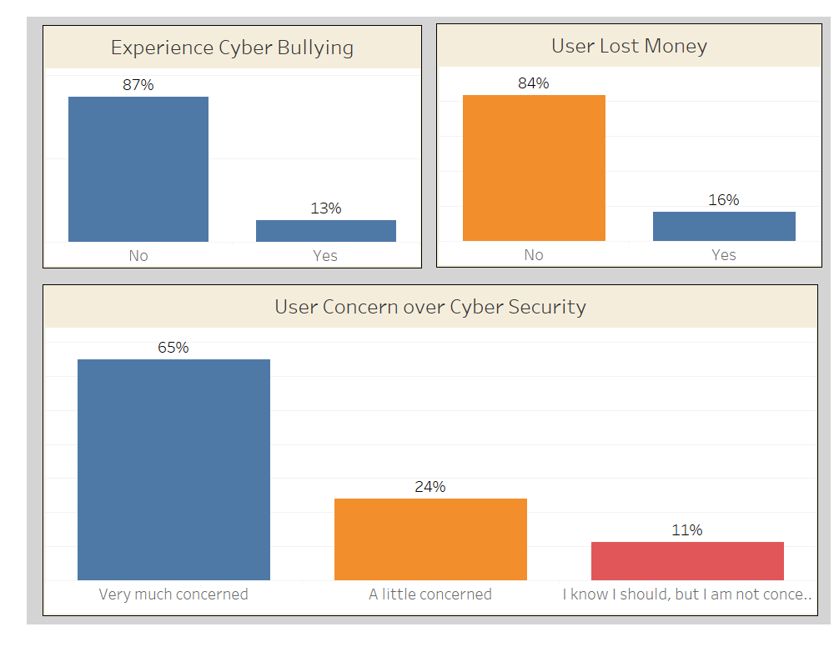
Respondents Experience and Perception about Cyber Bullying
Define Questions for the Data
Define Questions for the Data
eShield

Slide 16
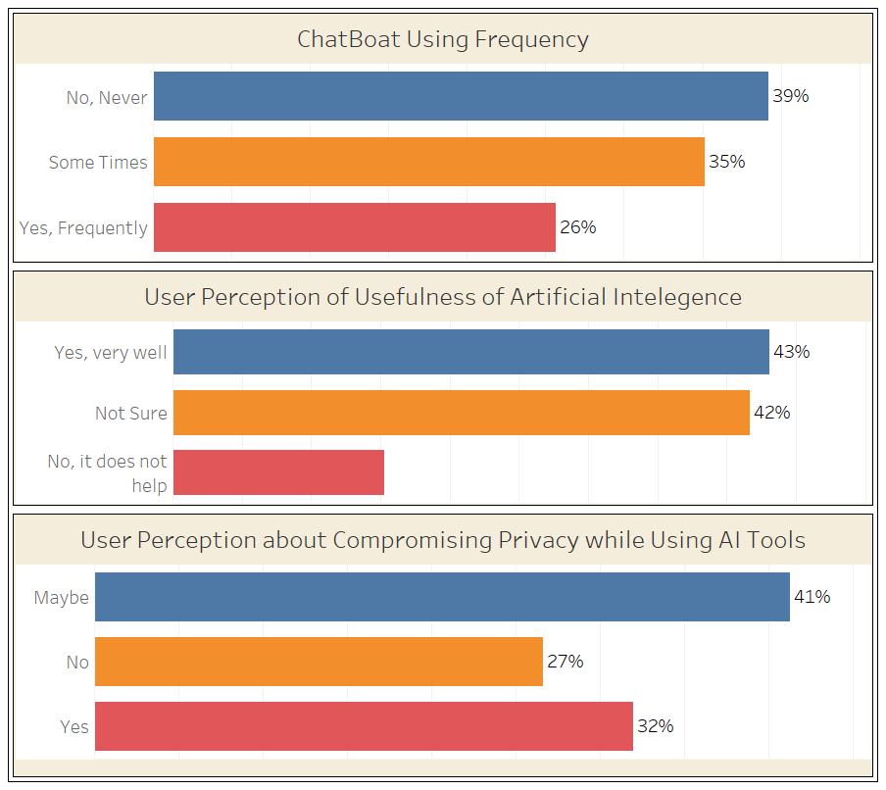
Perception about Artificial Intelligence Tools like Chatbot
61%
43%
Define Questions for the Data
Define Questions for the Data
eShield

Slide 17
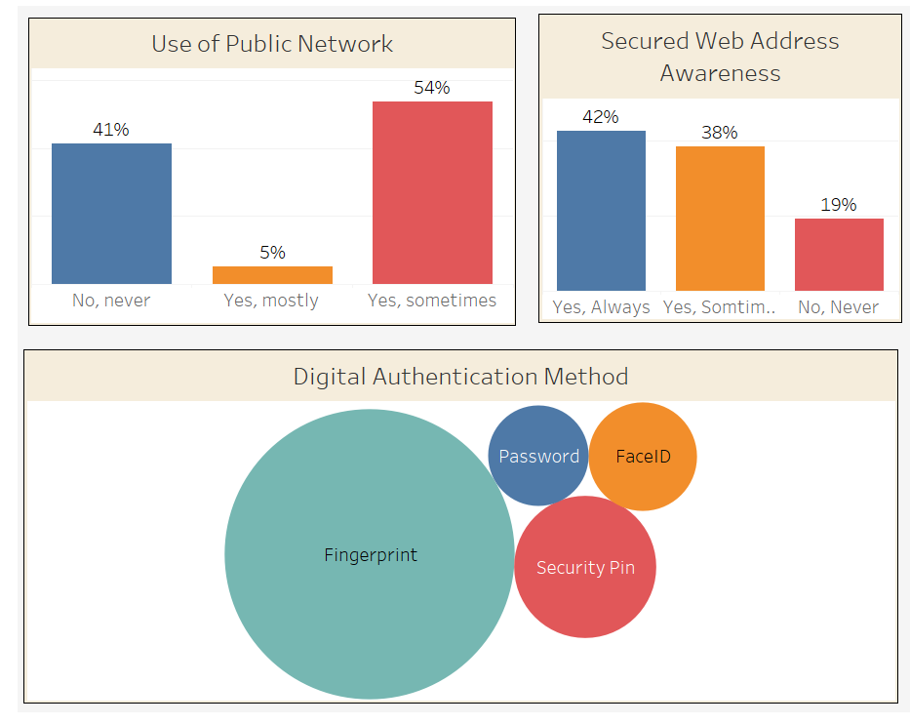
Digital Authentication and Precaution
Define Questions for the Data
Define Questions for the Data
Using Public Network and Browsing through https:\\ may not reduce risk of cyber fraud
eShield

Slide 18
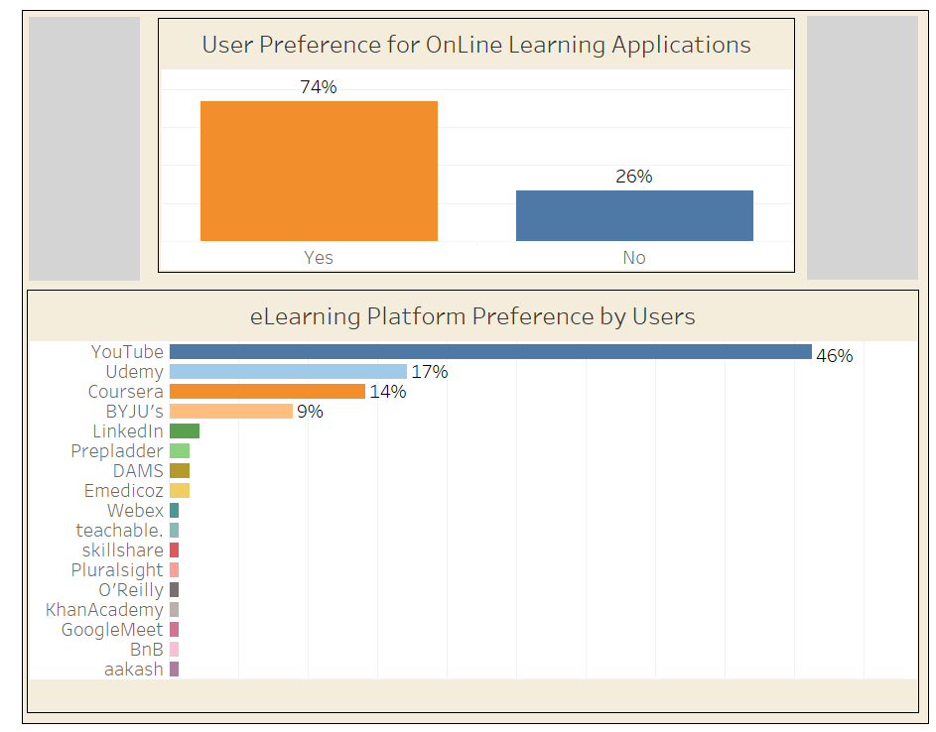
eLearning Platform
Define Questions for the Data
Define Questions for the Data
Top Three Learning Platforms
You Tube
Udemy
Coursera
eShield

Slide 19
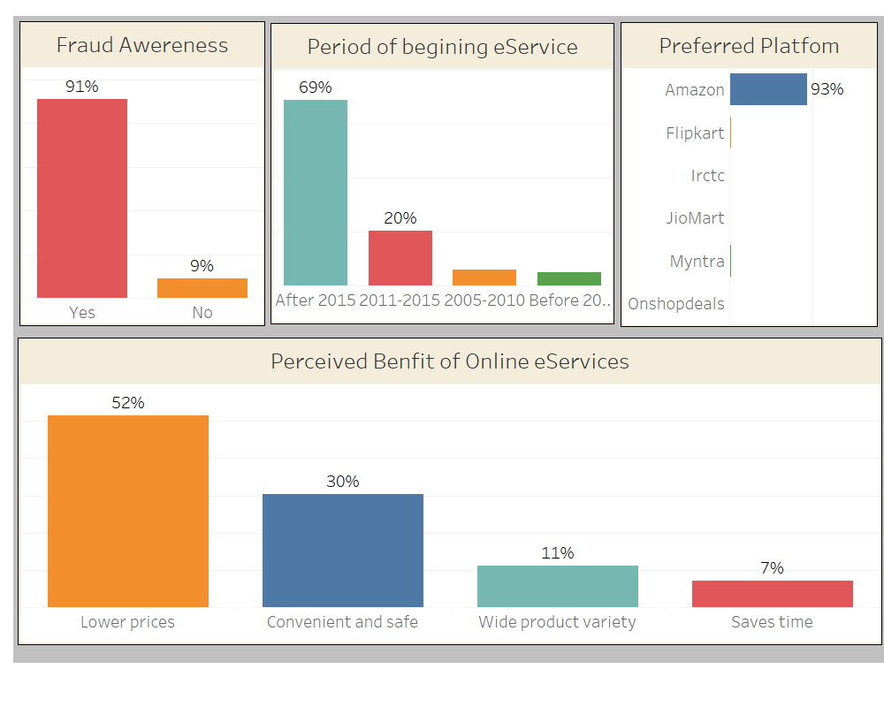
eServices
eService Growth
After Year 2015
Amazon is Most Popular
Define Questions for the Data
Define Questions for the Data
Key Factors for User Preference
Lower Price and Convenience
eShield

Slide 20
Method
Define research Questions
Data Collection
Data Normalization
Exploratory Analysis
Predictive Analysis
Conclusion
eShield

Slide 21
Objective
Objective :
Predict how concerned are people about security on internet based on Demographic Information
Logistic Regression Model
Market Basket Analysis: To find the Rules where Concern = “Yes”
eShield

Slide 22
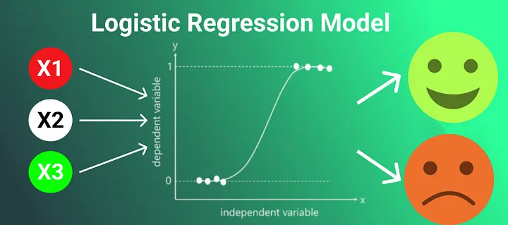
Predict how concerned are people about security on internet
Response Variable : Binary
1-> Very much concerned
2-> Not concerned
Explanatory Variable
Demographics (i.e Age, Gender, Profession, income)
Define Questions for the Data
Define Questions for the Data
One hot encoding
SMOTE to balance date
Backward elimination
Validation : ROC Curve
Testing
eShield

Slide 23
Predict how concerned are people about security on internet
Initial Model
logistic_model <- glm(concern_binary ~ is_male + is_female + age_group + is_graduate + is_postgraduate + is_schooling + is_other_education + is_business + is_service + is_student + is_homemaker + income_group, family = binomial, data = data)
Final Model
Call:
glm(formula = concern_binary ~ age_group + is_student, family = binomial,
data = data)
Coefficients:
Estimate Std. Error z value Pr(>|z|)
(Intercept) 5.0151 1.6287 3.079 0.002076 **
age_group -1.7268 0.6137 -2.814 0.004897 **
is_student -3.5396 1.0728 -3.299 0.000969 ***
Concern depends on
“ age group” and category “ student”
Define Questions for the Data
eShield

Slide 24
Predict how concerned are people about security on internet
Metric | Formula | Training | Validation
TP |  | 25 | 37
TN |  | 52 | 27
FP |  | 33 | 21
FN |  | 6 | 19
Accuracy | (TP + TN) / sum(c(TP, TN, FP, FN)) | 0.614 | 0.595
Precision | TP / sum(c(TP, FP)) | 0.431 | 0.638
Recall (Sensitivity) | TP / sum(c(TP, FN)) | 0.806 | 0.661
Specificity | TN / sum(c(TN, FP)) | 0.612 | 0.563
F1 Score |  | 0.562 | 0.649
Define Questions for the Data
Define Questions for the Data
eShield

Slide 25
Random Forest
Dependent Variable :
“ Fraud Awareness ”

Slide 26
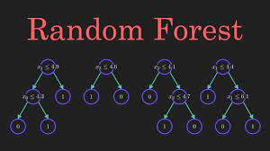
Predict who are people not Fraud Aware
Using Random Forest Method
fraud_awareness
Explanatory Variables
doing_transaction
transaction_method
concerned
os_update
public_network
information_security_knowledge
data_backup
data_backup_scheule
network_security
lost_money
two_factor
gender
Age
Education
Occupation
income
Define Questions for the Data
Define Questions for the Data
Tree 500
Number of variable 4 ~ SQRT(16)
Used smote to upsize data
eShield

Slide 27
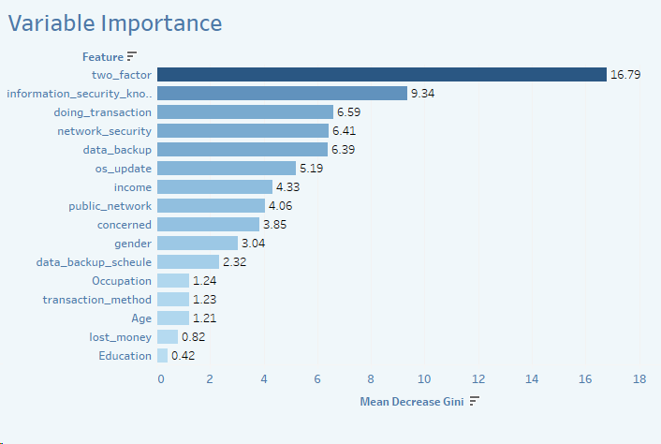
Predict how are people not Fraud Aware
100% Accuracy to predict Fraud Awareness on train, testing, all data
Define Questions for the Data
Define Questions for the Data
eShield

Slide 28
Summary
Summary of Analysis
Random Forest fits well with Training and Testing Data to predict Awareness about Cyber Frauds so new observation can be predicted.
Increase Awareness through Targeted add campaigns
Product Offerings (antivirus software, encryption tools
Define Questions for the Data
eShield

Slide 29
Market Basket
Dependent Variable :
“ Concern = Very much concerned ”

Slide 30

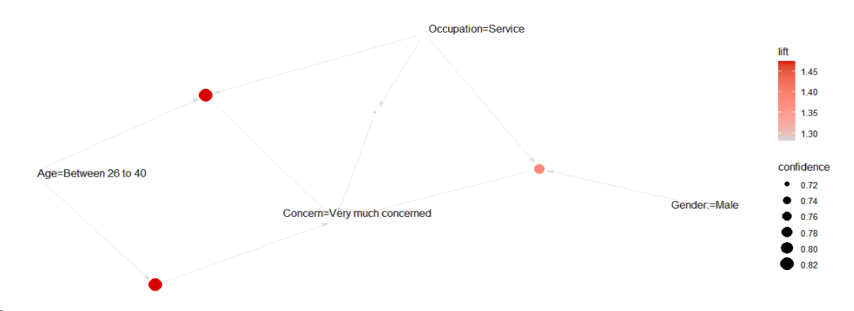
Predict how concerned are people about security on internet
Using Market Basket Analysis to find the rules that has right hand side as
Very much concerned
lhs | rhs | support | confidence | coverage | lift
{Age=Between 26 to 40} | => {Concern=Very much concerned} | 0.2211538 | 0.8214286 | 0.2692308 | 1.472906
{Occupation=Service} | => {Concern=Very much concerned} | 0.3365385 | 0.7142857 | 0.4711538 | 1.280788
{Age=Between 26 to 40, Occupation=Service} | => {Concern=Very much concerned} | 0.2211538 | 0.8214286 | 0.2692308 | 1.472906
{Gender:=Male, Occupation=Service} | => {Concern=Very much concerned} | 0.2884615 | 0.7692308 | 0.3750000 | 1.379310
Define Questions for the Data
Define Questions for the Data
eShield

Slide 31
Summary
Summary of Analysis
More Concerned about Cyber Security
Age group 26 to 40
Occupation : Service
Gender : Male
Define Questions for the Data
eShield

Slide 32
Market Basket
Dependent Variable : “ Fraud Awareness=No”
eShield

Slide 33
Objective:
Predict who are people not Fraud Aware
Using Market Basket Analysis to find the rules that has right hand side as
fraud_awareness = No
lhs | rhs | support | confidence | lift
------------------------------------------ | ----------------------- | -------------- | ------------ | -----
{information_security_knowledge=No, | {fraud_awareness=No} | 0.02884615 | 1 | 26
data_backup=No,
two_factor=No,
Gender:=Female}
------------------------------------------ | ----------------------- | -------------- | ------------ | -----
{public_network=Yes, sometimes, | {fraud_awareness=No} | 0.02884615 | 1 | 26
data_backup=No,
two_factor=No,
Gender:=Female}
------------------------------------------ | ----------------------- | -------------- | ------------ | -----
{transaction_method=UPI, | {fraud_awareness=No} | 0.02884615 | 1 | 26
data_backup=No,
two_factor=No,
Gender:=Female}
------------------------------------------ | ----------------------- | -------------- | ------------ | -----
{transaction_method=UPI, | {fraud_awareness=No} | 0.02884615 | 1 | 26
information_security_knowledge=No,
data_backup=No,
two_factor=No,
Gender:=Female}
------------------------------------------ | ----------------------- | -------------- | ------------ | -----
Define Questions for the Data
Define Questions for the Data
Strong association for the absence of fraud awareness
eShield

Slide 34
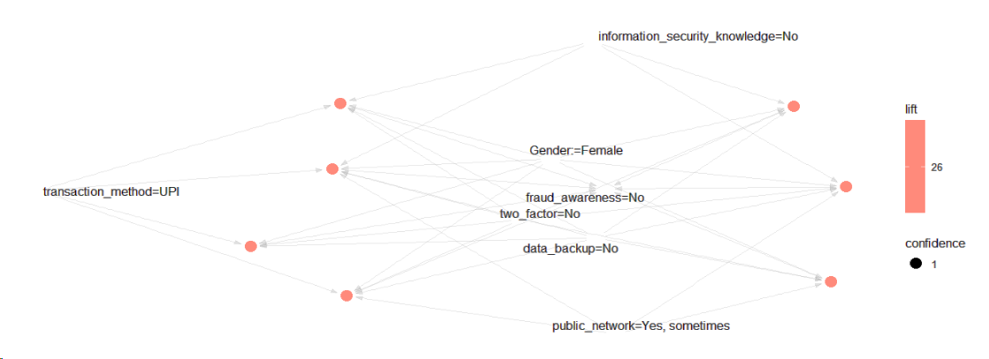
Predict who are the people not Fraud Aware
Visualization of Rules
Define Questions for the Data
Define Questions for the Data
eShield

Slide 35
Summary
Summary of Analysis
Categories : No Awareness about Cyber Frauds
lack of information security knowledge,
no data backup,
no two-factor authentication,
and are female,
Define Questions for the Data
eShield

Slide 36
Market Basket
Dependent Variable :
“ eLearning Platform”

Slide 37
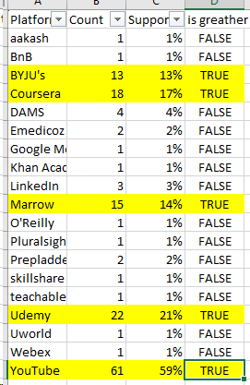
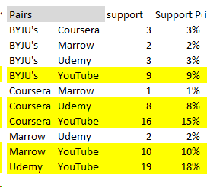
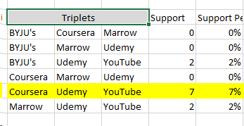
Study the usage pattern of online learning platform in combinations
Study the usage pattern of online learning platform in combinations
Minimum Support | 5%
Minimum Threshold | 75%
Define Questions for the Data
Define Questions for the Data
eShield

Slide 38
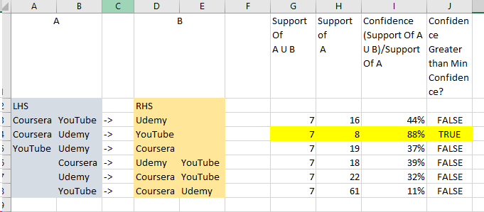
Study the usage pattern of online learning platform in combinations
Study the usage pattern of online learning platform in combinations
Minimum Support | 5%
Minimum Threshold | 75%
Define Questions for the Data
Define Questions for the Data
Conclusion with 88% confidence we can say that
people using Coursera and Udemy also uses YouTube.
eShield

Slide 39
Random Forest

Slide 40
Analysis :
Random Forest & Logistic Regression
Objective :
To analyze the characteristics of individuals susceptible to falling
Victim of Online Transaction Fraud
1. Important Features Selection
Random Forest
2. Predict susceptibility to online transaction losses
Logistic Regression
eShield

Slide 41
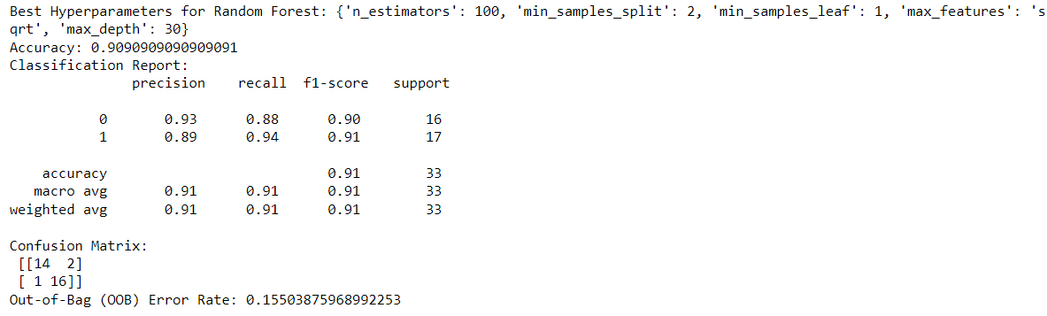
Random Forest
Important Features
Training Data Partiton : 80%
Testing Data Partiton : 20%
Random Forest hyperparameter tuning
Accuracy -Train Data = 100%
Accuracy -Test Data = 91%
OOB Eroor Rate = 15.5%
eShield

Slide 42
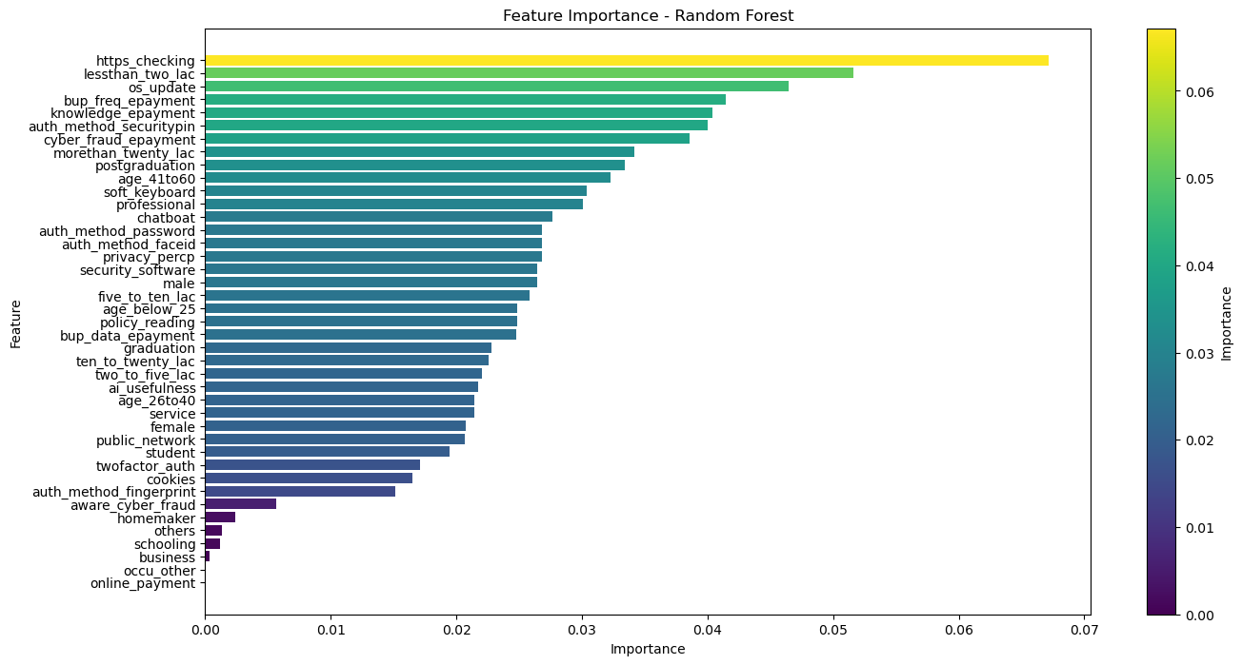
Random Forest
Important
Features
Pareto Rule
Application
Variable Importance Plot
eShield

Slide 43
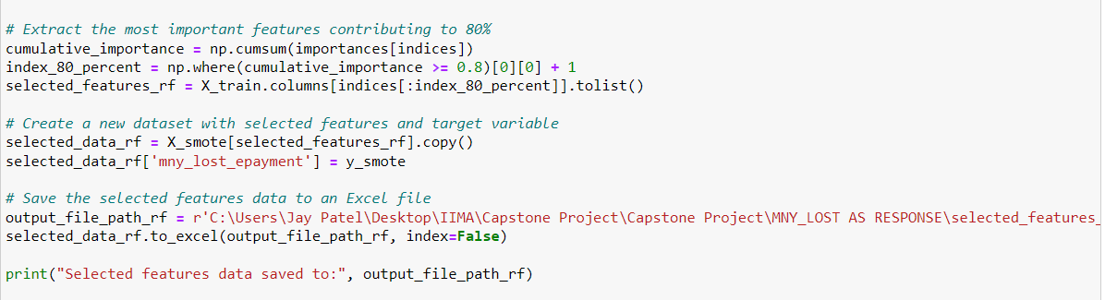
Important
Features
Pareto Rule
Application
Final Filtered
Features
Pareto Rule: Application
eShield

Slide 44
Random Forest
Important
Features
Pareto Rule
Application
Final Filtered
Features
Pareto Rule: Application
Important Features: 41
Filtered Important Features : 22
eShield

Slide 45
Analysis :
Random Forest & Logistic Regression
Objective :
To analyze the characteristics of individuals susceptible to falling
Victim of Online Transaction Fraud
1. Important Features Selection
Random Forest
2. Predict susceptibility to online transaction losses
Logistic Regression
eShield

Slide 46
Data Splitting
Logistic
Regression
Back ward
Elimination
Final Model
Summary
Raw Data
Training: 70%
Validation: 15%
Testing: 15%
eShield

Slide 47
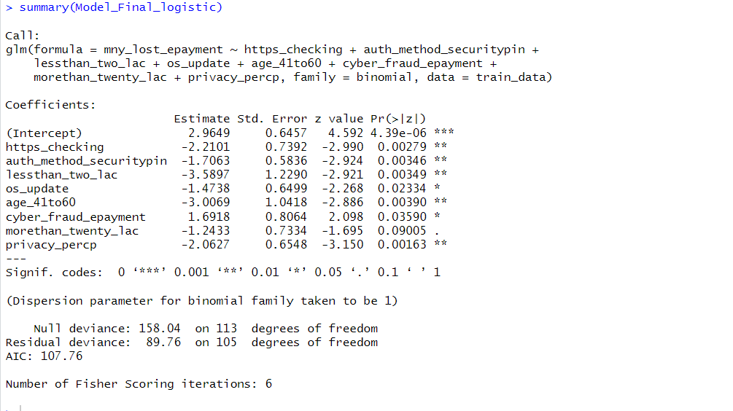
Finding : Significant Variable
Logistic
Regression
Back ward
Elimination
Final Model
Summary
Back ward Elimination Method
Model Summary
Threshold Value Cut off
VIF<4
P value < 0.1
eShield

Slide 48
Logistic
Regression
Back ward
Elimination
Final Model
Summary
eShield

Slide 49
Logistic
Regression
Back ward
Elimination
Final Model
Summary
Significant Variables
8
Variables with highest intercept :
less_than_two_lac
age_41to60
eShield

Slide 50
Logistic
Regression
Back ward
Elimination
Final Model
Summary
Summary of Analysis
Respondents not losing money for following variables
https checking
authorisation by security pin
less than two lac salary
regular OS update
age bracket 41 to 60
more than twenty lac
concerned for privacy
eShield

Slide 51
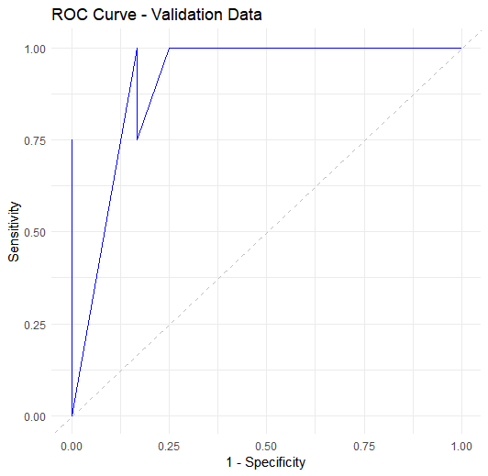
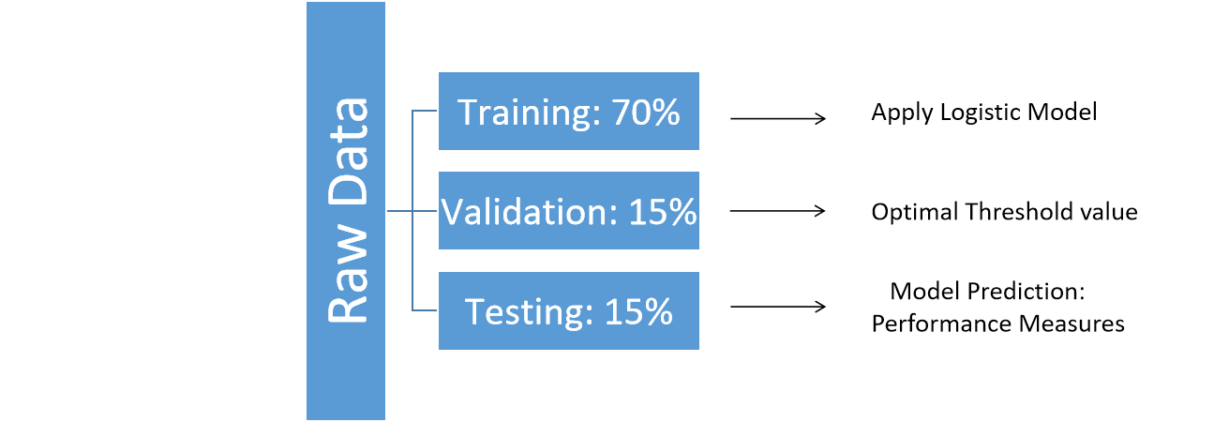
Model Prediction- Logistic Regression
Logistic
Regression
Back ward
Elimination
Final Model
Summary
F1 Score
Priority
eShield

Slide 52
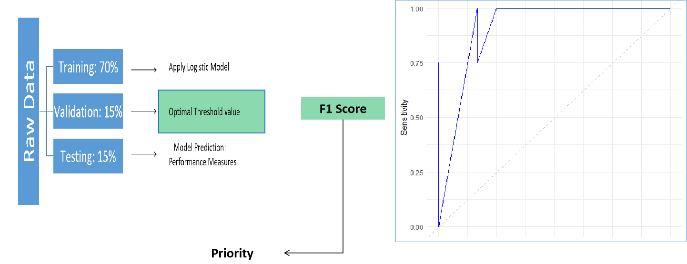
Model Prediction- Logistic Regression
Logistic
Regression
Back ward
Elimination
Final Model
Summary
Optimal Threshold: 0.23
AUC: 0.95
eShield

Slide 53
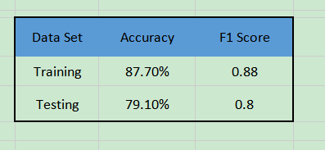
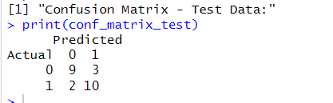
Model Prediction- Logistic Regression
Logistic
Regression
Back ward
Elimination
Final Model
Summary
Performance Matrics Comparision
eShield

Slide 54
Method
Define research Questions
Data Collection
Data Normalization
Exploratory Analysis
Predictive Analysis
Conclusion
eShield

Slide 55
Conclusion
Integrated Insights
Cyber Security Concerns:
Logistic Regression: Age group and student status influence concerns.
Random Forest: Successfully predicts cyber fraud awareness.
Apriori Rules: Higher concern in age 26 to 40, service occupation, and male gender.
Fraud Awareness:
Apriori Rules: Lack of awareness linked to no information security knowledge, no data backup, no two-factor authentication, and female gender.
Fraud Loss Prediction:
Random Forest: Non-loss characteristics include HTTPS checking, security pin authorization, income less than two lac, regular OS updates, age 41 to 60, income more than twenty lac, and privacy concern.
Logistic Regression: Effective in predicting money loss.
eShield

Slide 56
Next Steps
Applications
Concentrated Ad Campaigns
Develop and market cybersecurity products
Establish targeted educational programs
eShield

Slide 57
Thank You

